Slide 1


Aviation Data. 24TH Nov 2024 By Job Cheruyot

Slide 2
Incident Overview and Key Statistics (1980-2022)
Number of Incidents: 88,890
Number of Countries: 216
Period: 1980 to 2022
Weather Conditions: 3 Types
Engine Types: 10 Types
Incident Severity: Minor to Fatal

Slide 3

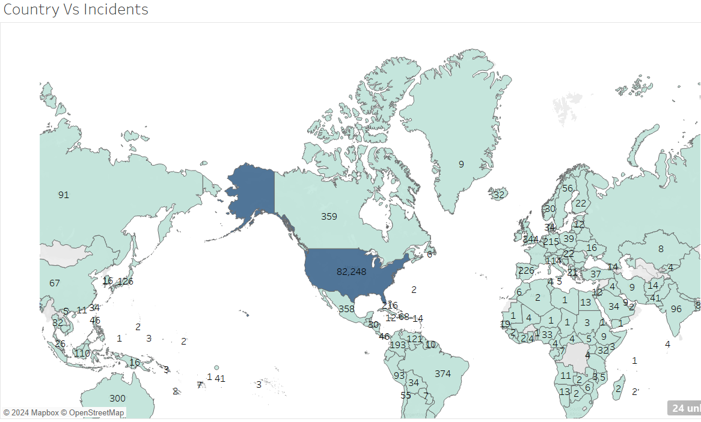
Incidents and Countries
United States accounts for 93 % of the recorded incidents.
This is due to its high volume of its air traffic and high standards of reporting
African countries has the least records with South Africa, Nigeria and Kenya taking the lead

Slide 4

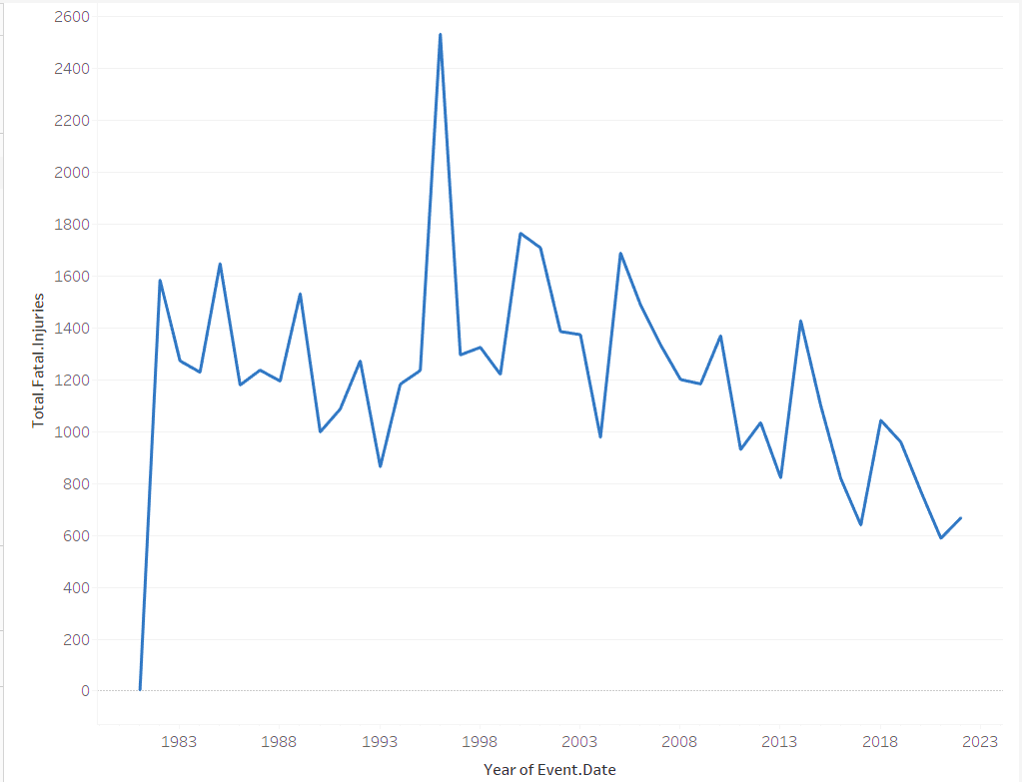
Accidents Trends
Aircraft accidents:
1996 Recorded the highest incidents
United states still registered the highest incidents

Slide 5

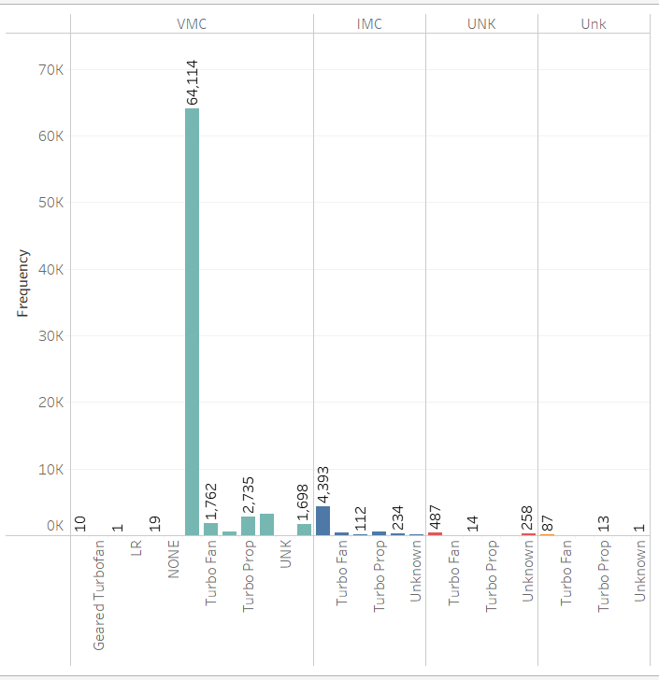
Weather Conditions
.
Weather is a significant contributor to the accident's occurrence irrespective of the type of aircraft
The best time to fly is under the Unk
Weather while the worst time is the VMC Weather Condition

Slide 6

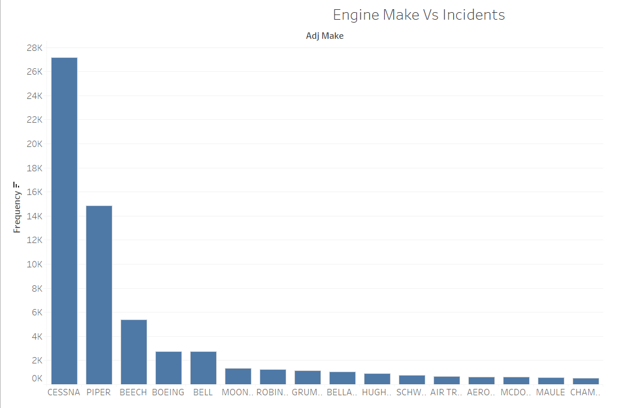
.
Most aircraft involved in incidents uses the Cessna Engines.
Cessna, Piper and Beech more likely to be involved in an accident under the VMC Weather condition

Slide 7
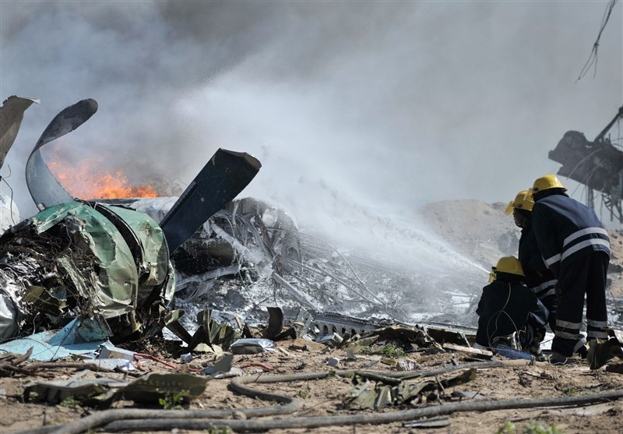
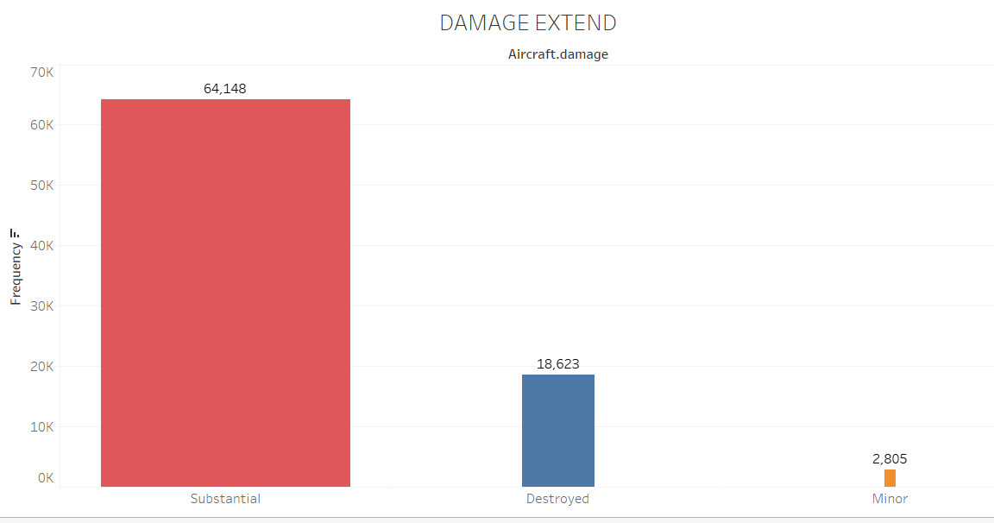
Damage Extend
97% of all the incidents recorded resulted in either the aircraft being completely or substantially destroyed

Slide 8

Thank You !

